Slide 1
OSI Network Layer
Dr. Muazzam A. Khan

Slide 2
Objectives
Identify the role of the Network Layer, as it describes communication from one end device to another end device.
Examine the most common Network Layer protocol, Internet Protocol (IP), and its features for providing connectionless and best-effort service.
Understand the principles used to guide the division or grouping of devices into networks.
Understand the hierarchical addressing of devices and how this allows communication between networks.
Understand the fundamentals of routes, next hop addresses and packet forwarding to a destination network.

Slide 3
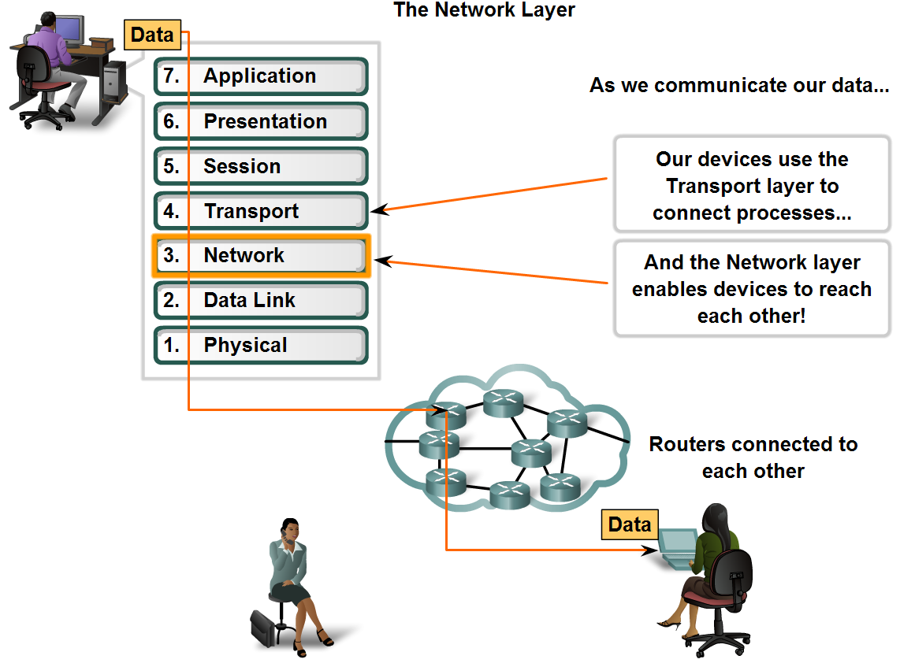
Network Layer Protocols and Internet Protocol (IP)
Define the basic role of the Network Layer in data networks

Slide 4
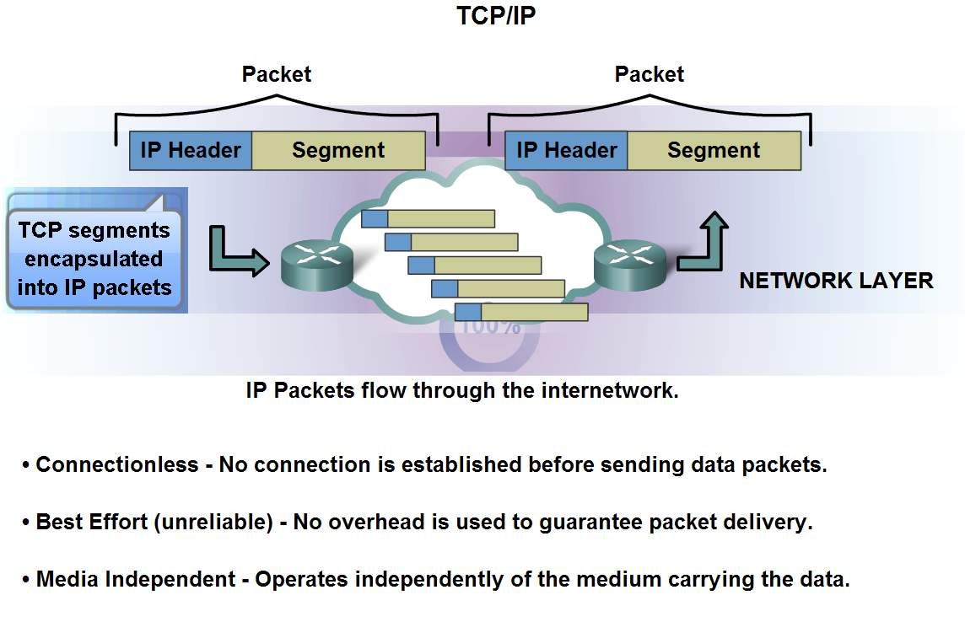
Network Layer Protocols and Internet Protocol (IP)
Identify the basic characteristics and the role of the IPv4 protocol

Slide 5
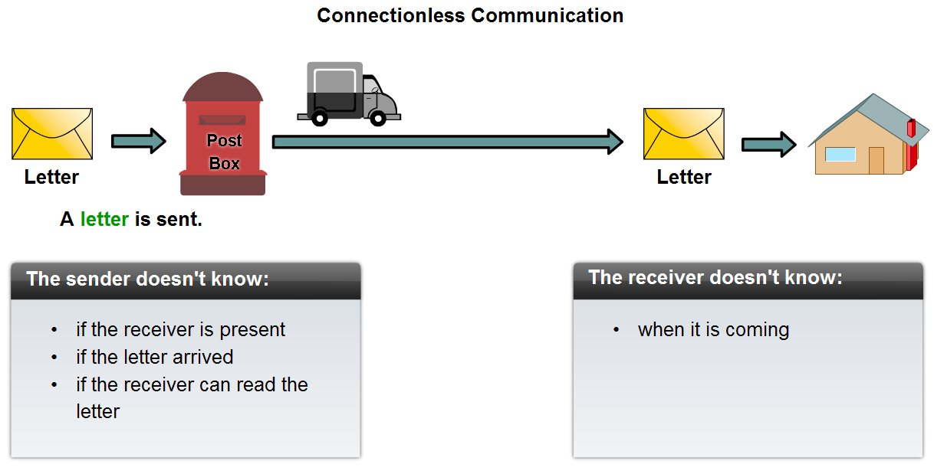
Network Layer Protocols and Internet Protocol (IP)
Describe the implications for the use of the IP protocol as it is connectionless

Slide 6
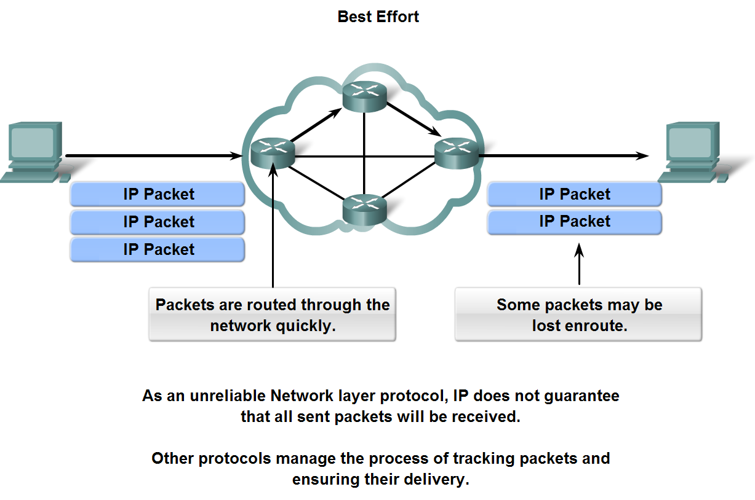
Network Layer Protocols and Internet Protocol (IP)
Describe the implications for the use of the IP protocol as it is considered an unreliable protocol

Slide 7
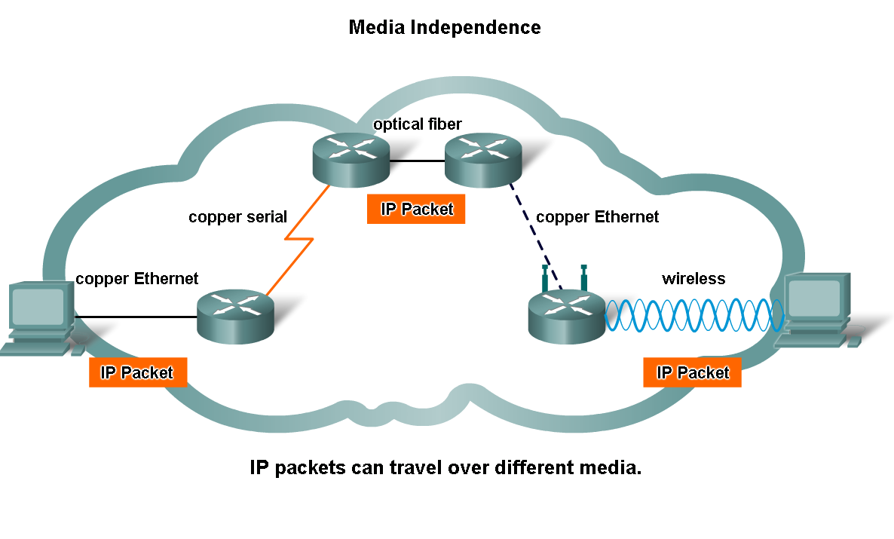
Network Layer Protocols and Internet Protocol (IP)
Describe the implications for the use of the IP as it is media independent

Slide 8
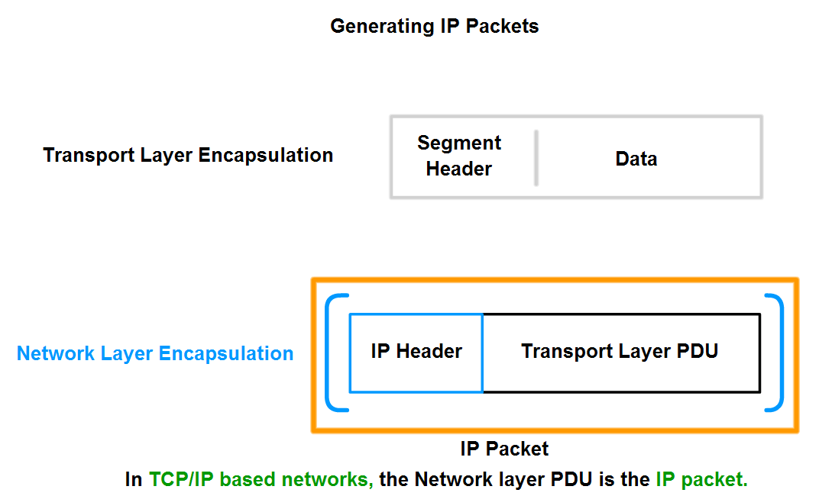
Network Layer Protocols and Internet Protocol (IP)
Describe the role of framing in the Transport Layer and explain that segments are encapsulated as packets

Slide 9
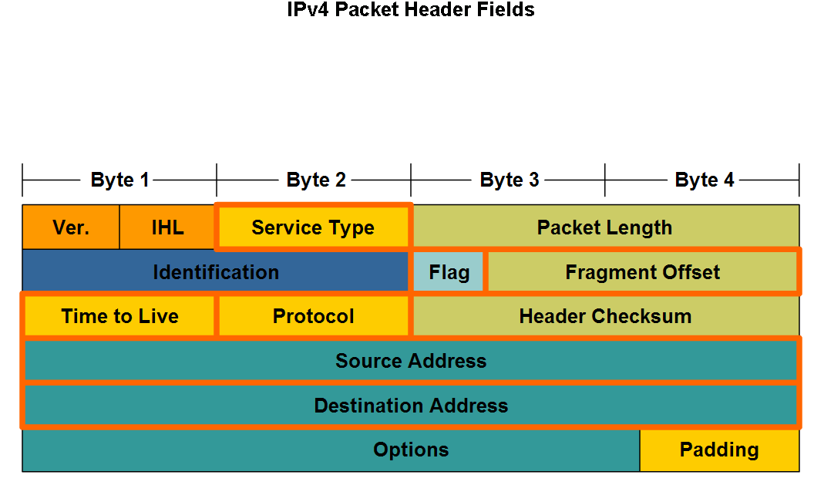
Network Layer Protocols and Internet Protocol (IP)
Identify the major header fields in the IPv4 protocol and describe each field's role in transporting packets

Slide 10
Major Header Fields

Slide 11
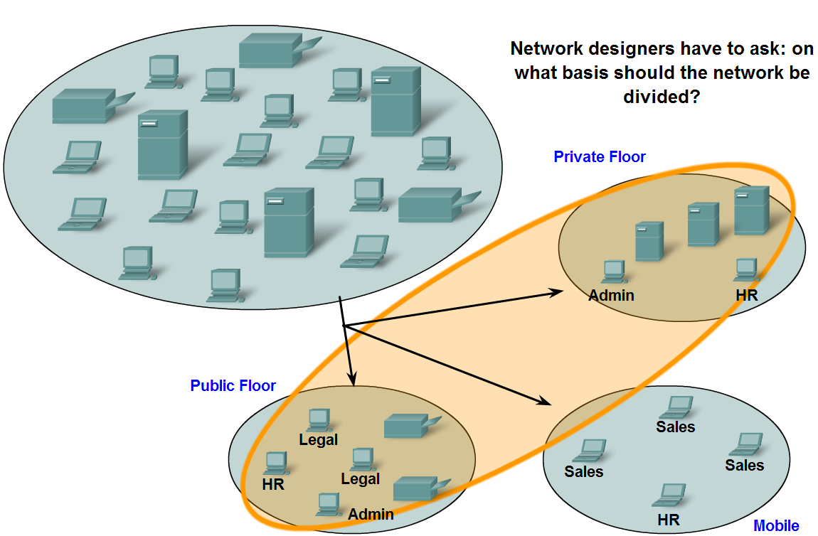
Grouping Devices into Networks and Hierarchical Addressing
List several different reasons for grouping devices into sub-networks and define several terms used to identify the sub-networks

Slide 12
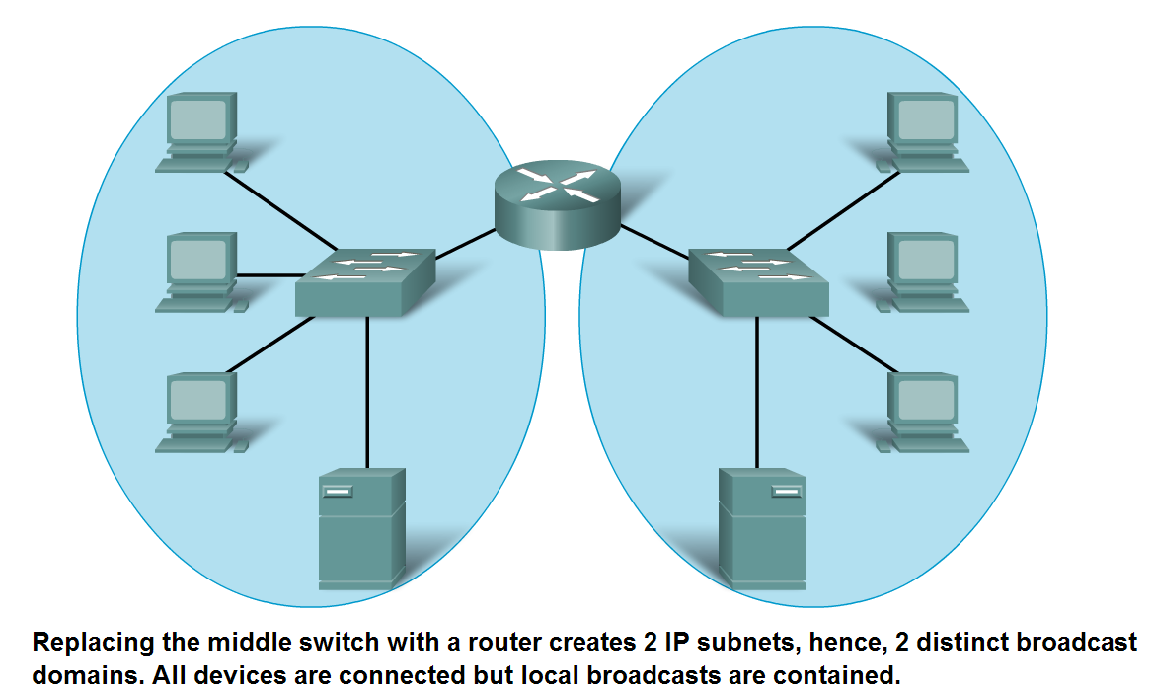
Grouping Devices into Networks and Hierarchical Addressing
List several ways in which dividing a large network can increase network performance

Slide 13
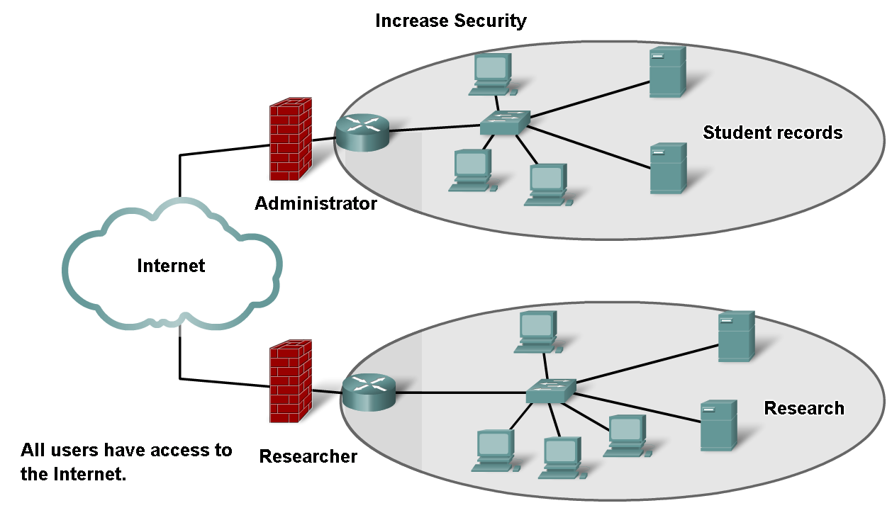
Grouping Devices into Networks and Hierarchical Addressing
List several ways in which dividing a large network can increase network security

Slide 14
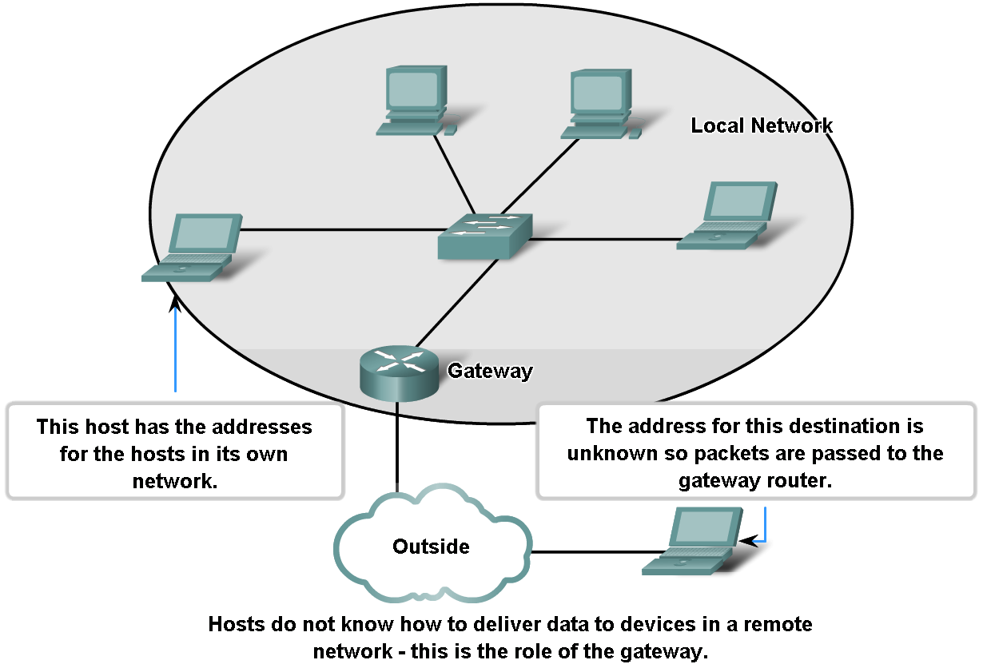
Grouping Devices into Networks and Hierarchical Addressing
Explain the communication problems that emerge when very large numbers of devices are included in one large network

Slide 15
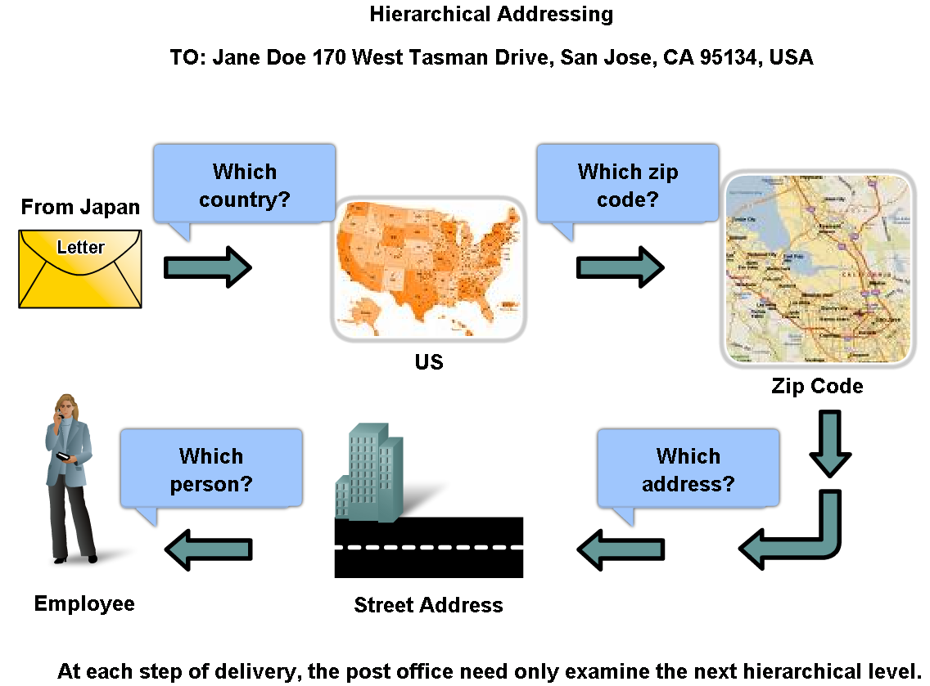
Grouping Devices into Networks and Hierarchical Addressing
Describe how hierarchical addressing solves the problem of devices communicating across networks of networks

Slide 16
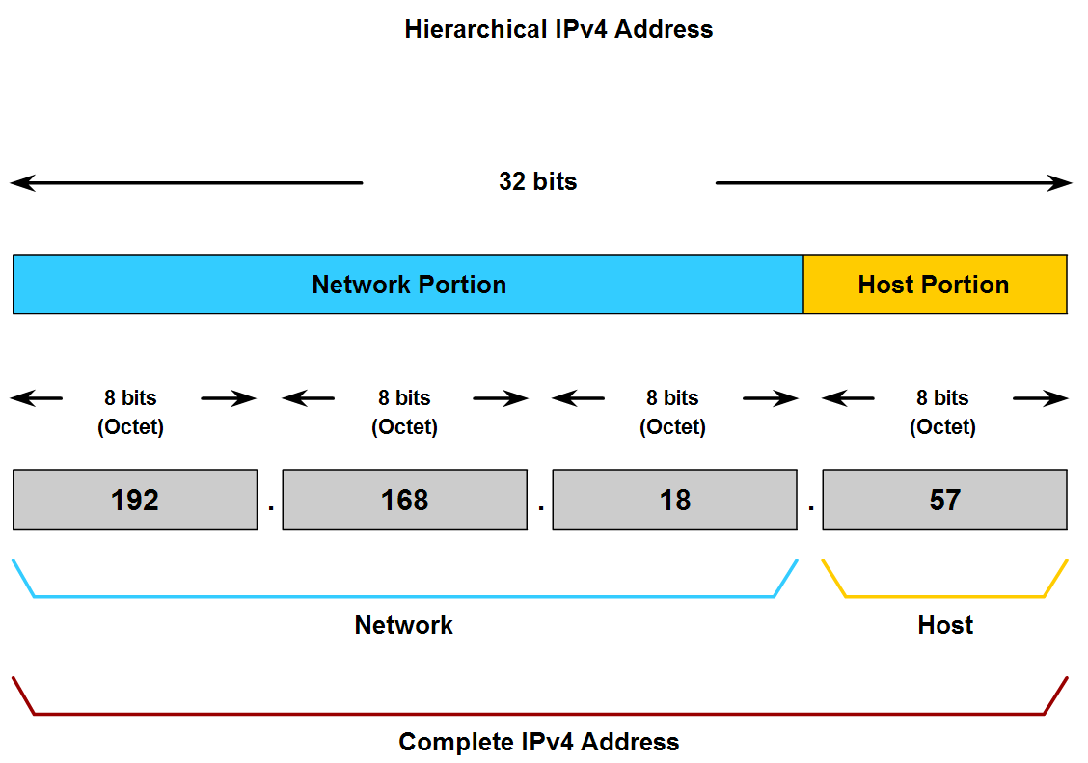
Grouping Devices into Networks and Hierarchical Addressing
Describe the purpose of further subdividing networks into smaller networks

Slide 17
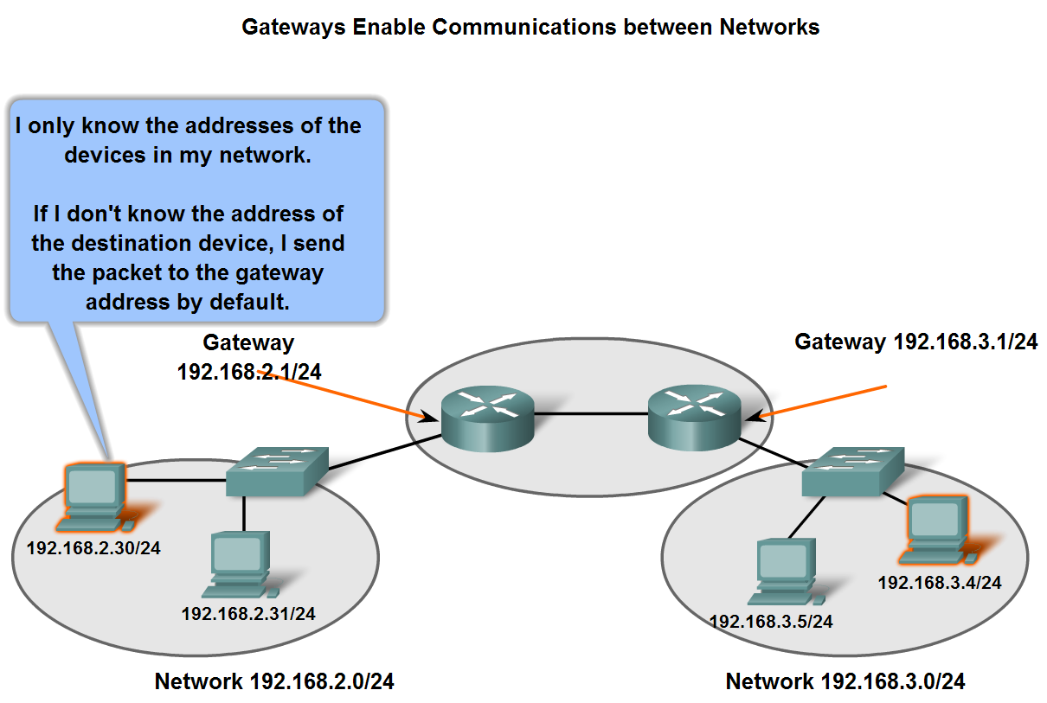
Fundamentals of Routes, Next Hop Addresses and Packet Forwarding
Describe the role of an intermediary gateway device in allowing devices to communicate across sub-divided networks

Slide 18
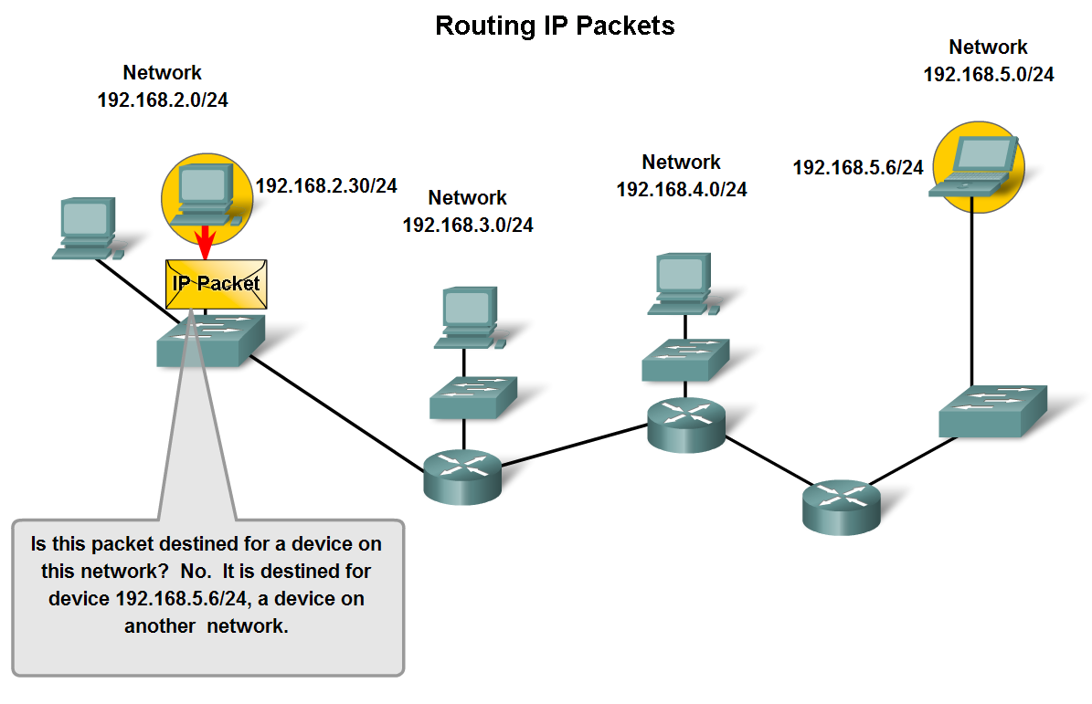
Fundamentals of Routes, Next Hop Addresses and Packet Forwarding
Trace the steps of an IP packet as it traverses unchanged via routers from sub network to sub-network

Slide 19
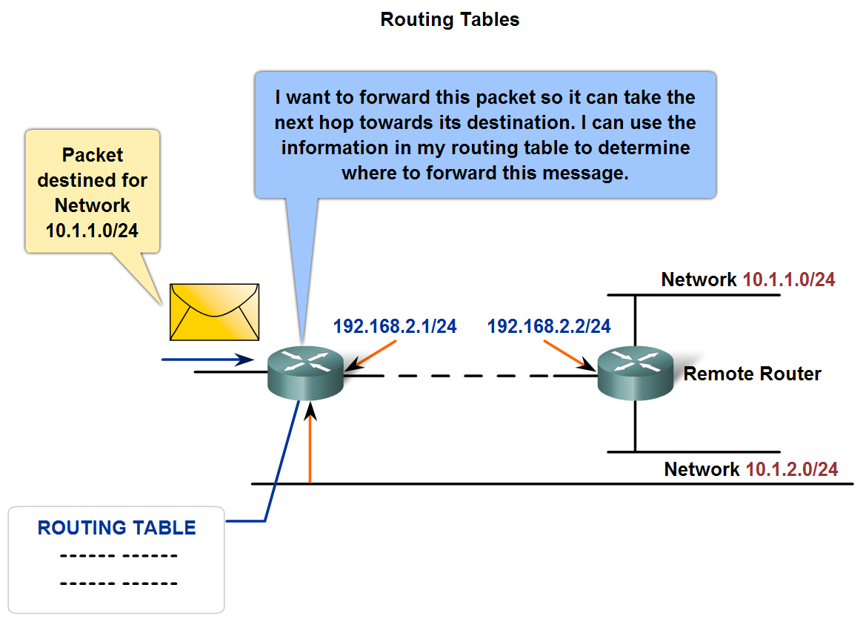
Fundamentals of Routes, Next Hop Addresses and Packet Forwarding
Describe the role of a gateway and the use of a simple route table in directing packets toward their ultimate destinations

Slide 20
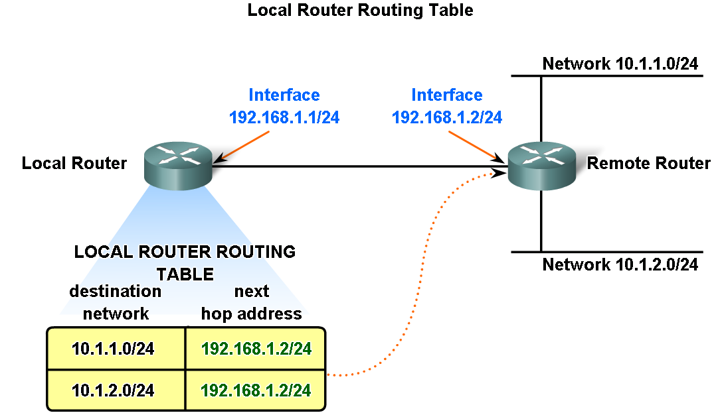
Fundamentals of Routes, Next Hop Addresses and Packet Forwarding
Define a route and its three key parts

Slide 21
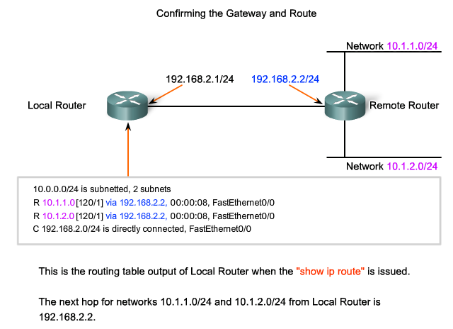
Fundamentals of Routes, Next Hop Addresses and Packet Forwarding
Describe the purpose and use of the destination network in a route

Slide 22
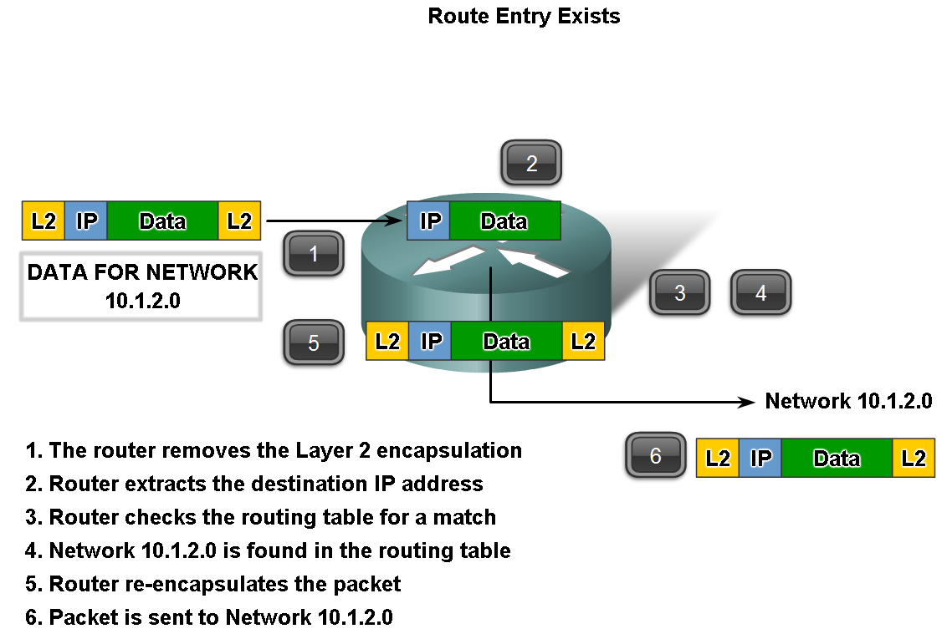
Fundamentals of Routes, Next Hop Addresses and Packet Forwarding
Trace the steps of several IP packets as they are routed through several gateways from devices on one sub network to devices on other sub networks

Slide 23
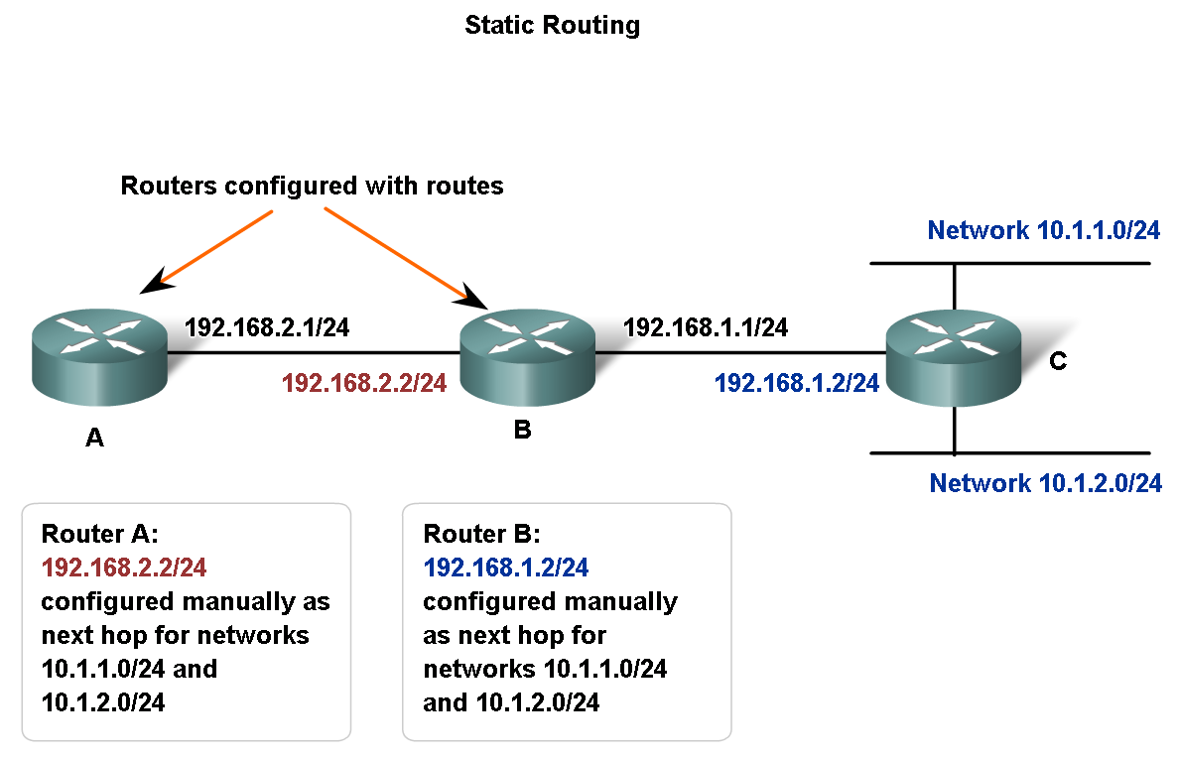
Fundamentals of Routes, Next Hop Addresses and Packet Forwarding
Describe the purpose of routing protocols and the need for both static and dynamic routes

Slide 24
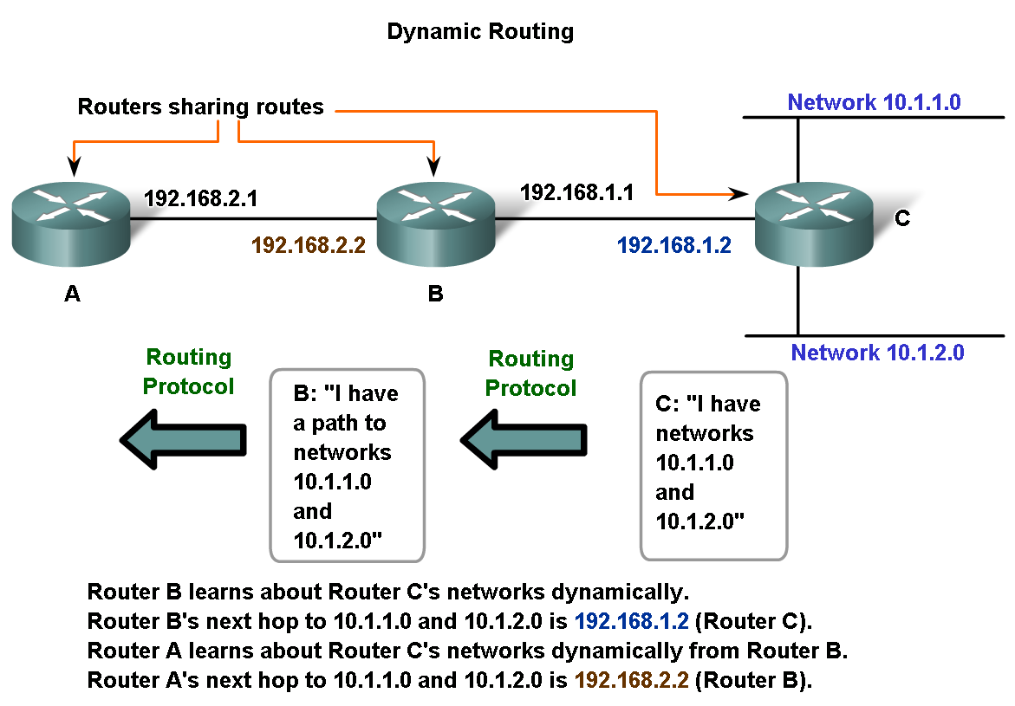
Fundamentals of Routes, Next Hop Addresses and Packet Forwarding
Explain how routes are manually configured to build routing table

Slide 25
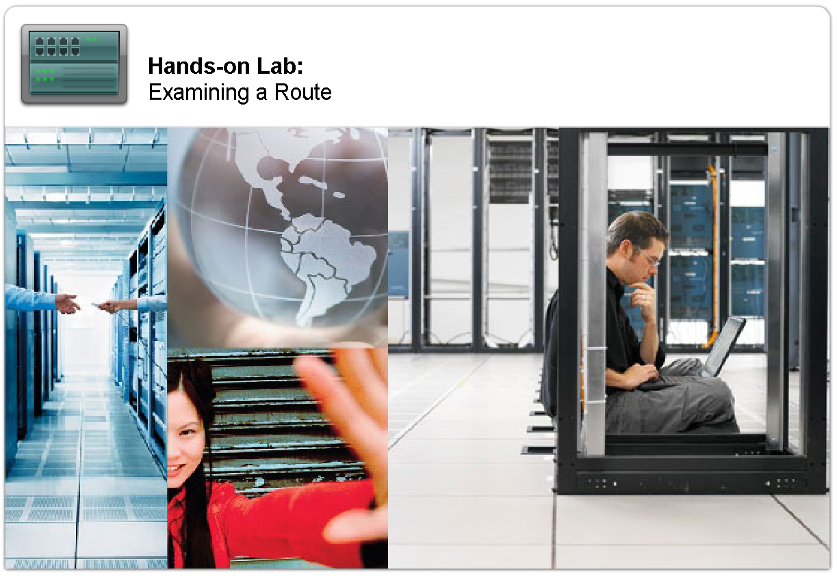
Fundamentals of Routes, Next Hop Addresses and Packet Forwarding
Explain the role of routing protocols in building the routing table

Slide 26
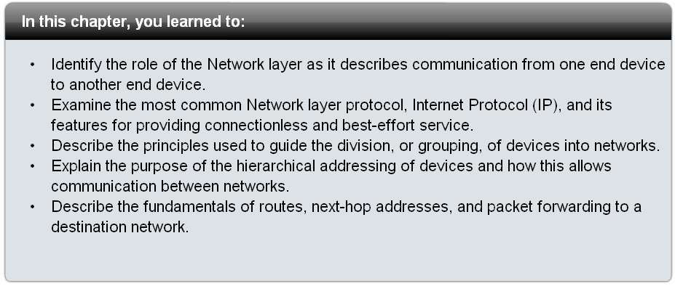
Summary

